Slide 1
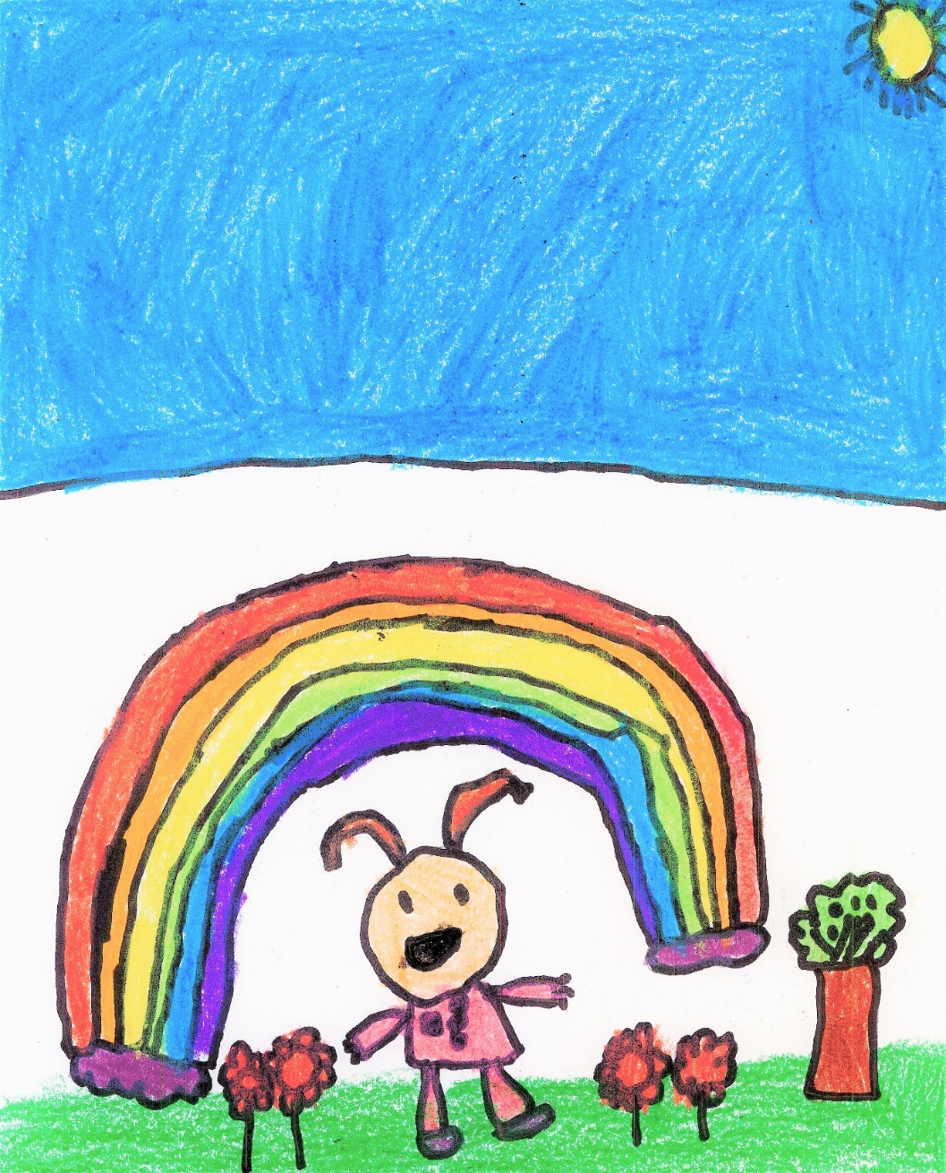
Welcome Class of 2034!
Kindergarten
and
Early Childhood
Information Parent Meeting

Slide 2
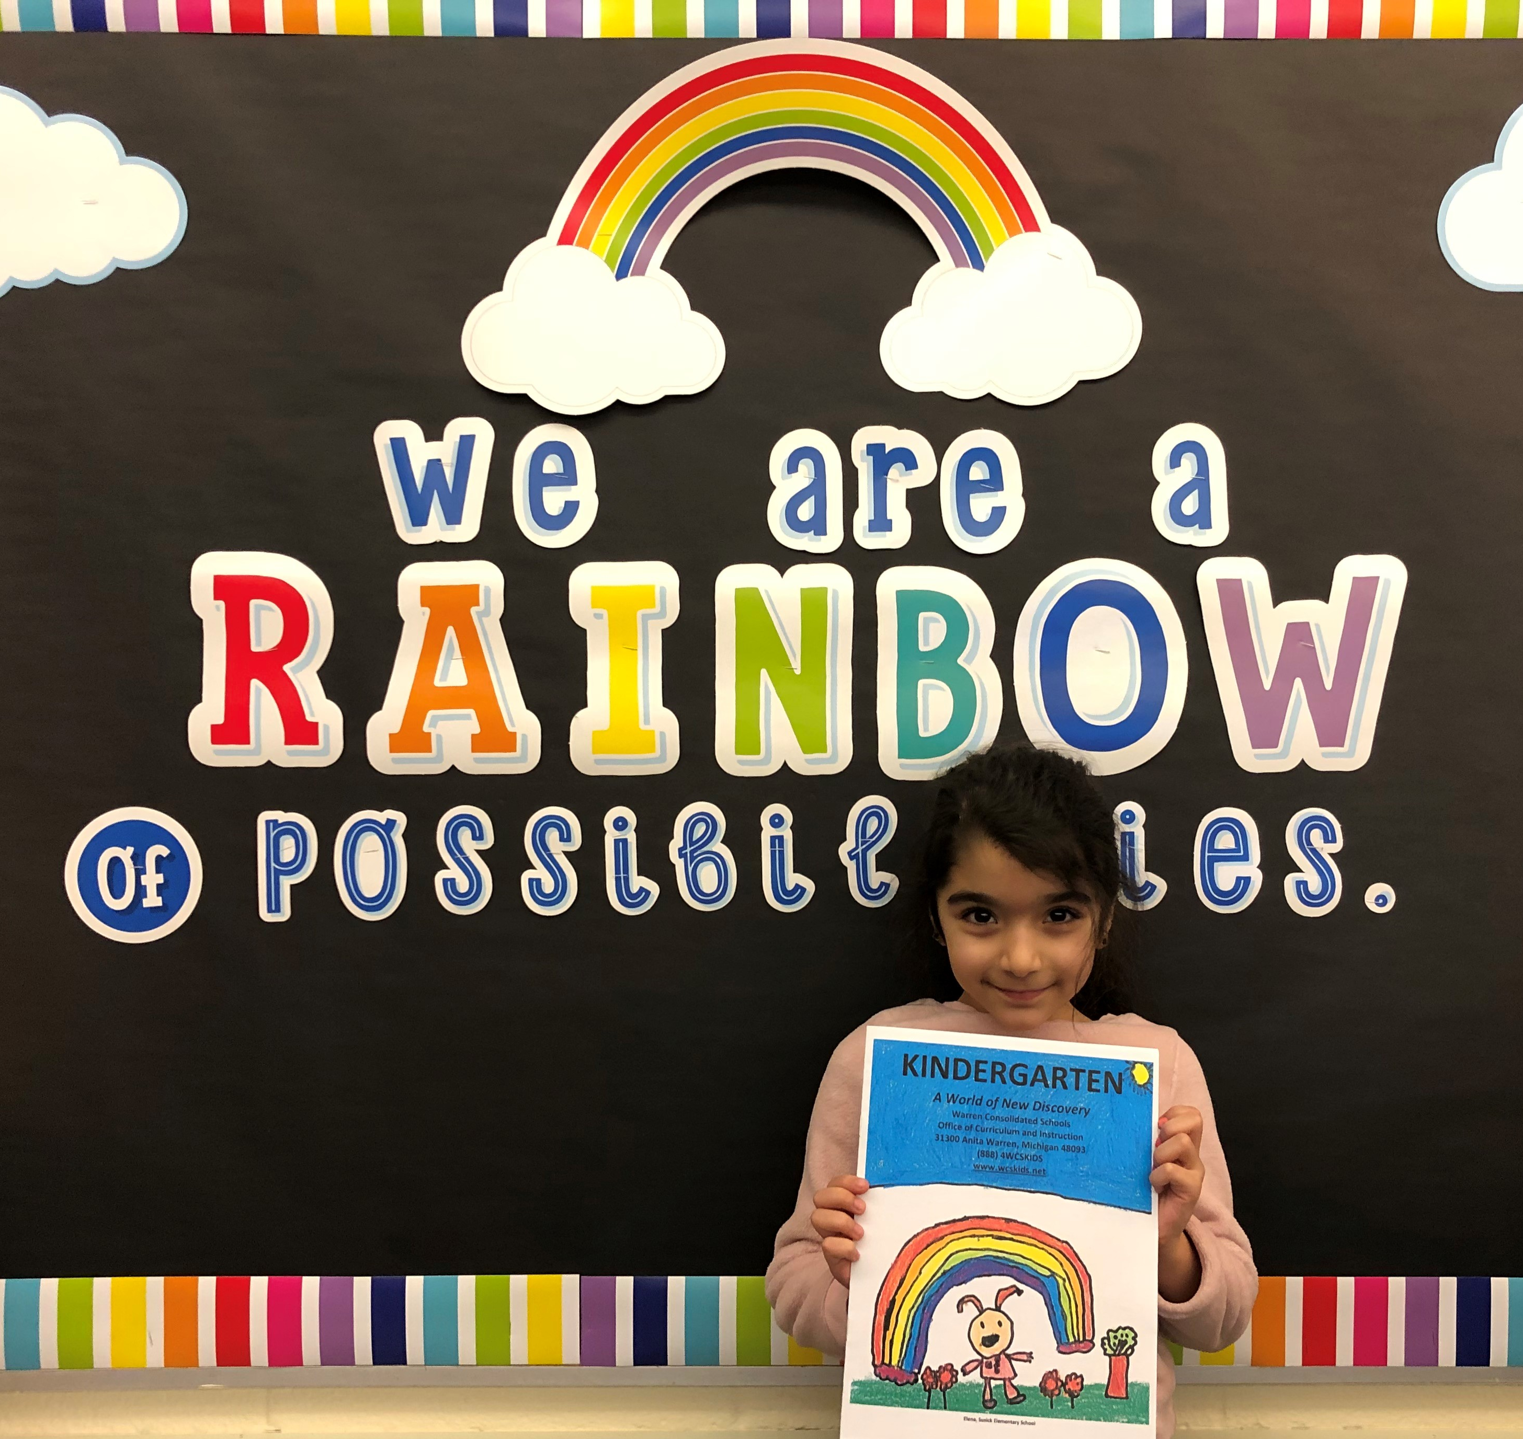
Parent Resources

Slide 3
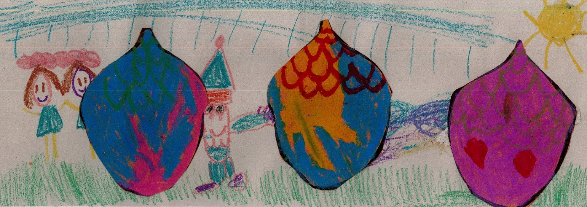
Agenda
Welcome and Introduction
A few words about Warren Consolidated Schools
Kindergarten Program Options
Kindergarten Curriculum
Registration Information

Slide 4
2034
No one is quite sure what the world will look like in 2034, when your child will graduate from high school.
Whatever students choose to pursue after high school, certain skills will be required.
-Literacy, math, and attendance
Our district is focused on creating opportunities to ensure achievement and success.

Slide 5
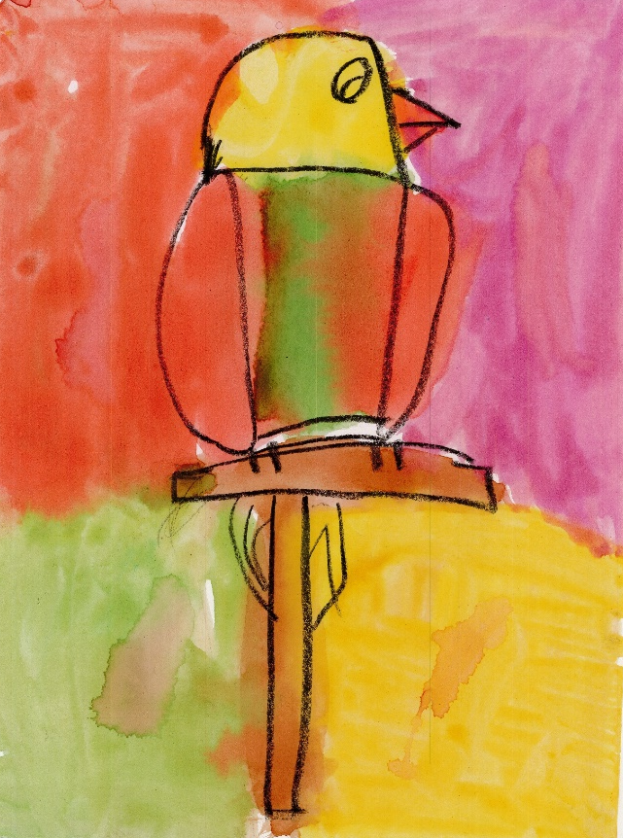
achievement
Literacy, Mathematics, and Attendance
MLPP/DRA
NWEA

Slide 6
NWEA’S MAP ASSESSMENT

Slide 7
Success
Middle School Math Science and Technology Center, MS2TC (grades 6-8)
Middle School Visual and Performing Arts Center, MSVPA (grades 6-8)
Macomb Mathematics Science Technology Center, MMSTC (grades 9-12)
Warren Consolidated School of Performing Arts, WCSPA (grades 9-12)
Career Prep Center, CPC (grades 10-12)

Slide 8
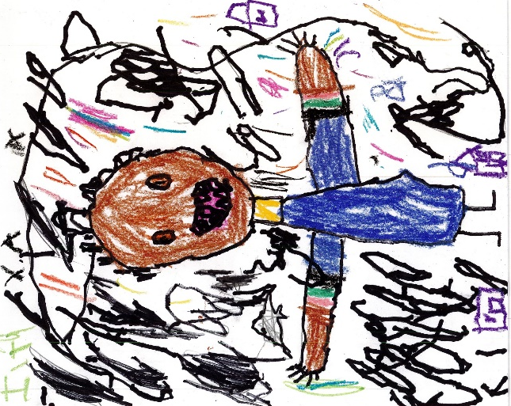
Our Student Support Network
As part of our focus on success, our district has worked hard on the development of our student support network.
Care – A focus on the whole child
Membership – Feeling connected
to your school
Safety – Emotionally and
physically safe spaces
Support – Advocacy for all

Slide 9
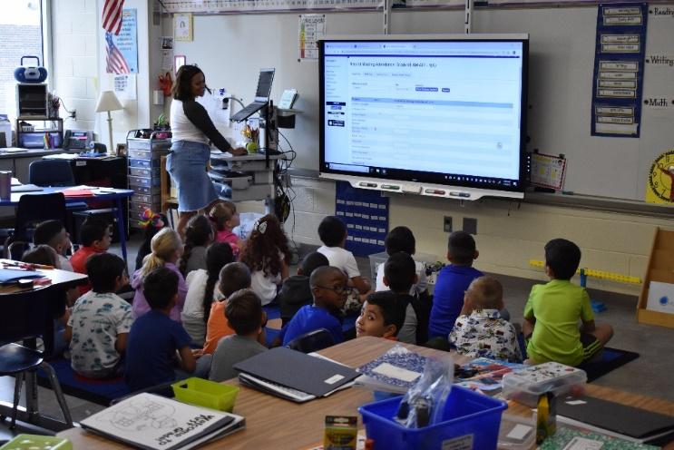
Your place for all kindergarten information
Tomorrow morning, a website: wcskids.net/ClassOf2034 will be available with important information.
Beginning tomorrow morning, incoming families will be asked to complete a “Hold My Spot” form so your child’s school can begin contacting you.
Throughout the spring, you will get updates from your child’s school, including some opportunities to come to the building and pick up some free Kindergarten preparation materials.

Slide 10
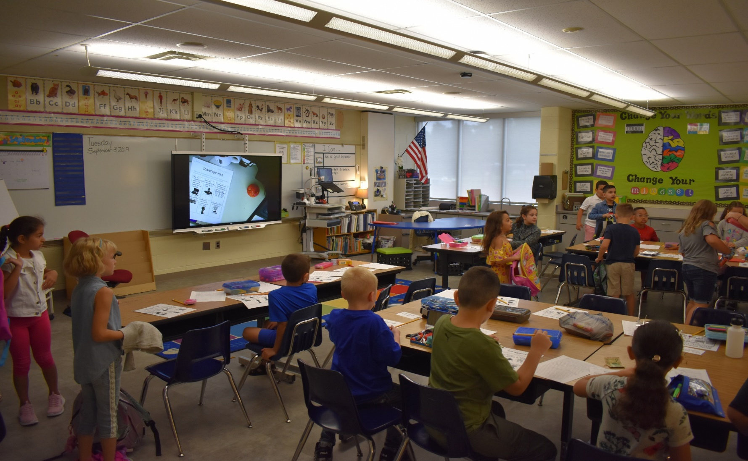
A TYPICAL KINDERGARTEN CLASSROOM

Slide 11
Age requirements
KINDERGARTEN ENTRY FREQUENTLY ASKED QUESTIONS
The entry age for kindergarten in a Michigan public school or a public school academy has gradually changed since 2013 and requires that children be 5 years old by September 1st. Michigan joined the majority of states that require students to reach age 5 before enrolling in a public school and/or a public school academy. **
Kindergarten is a great opportunity for learning but is voluntary in the State of Michigan, meaning that kindergarten attendance is permitted but not required. **
**State of Michigan, 96th Legislature, Regular Session of 2012
**MI Revised School Code 380.1147: Enrollment of children in kindergarten
QUESTION | ANSWER
1. What is the age my child must be to enter kindergarten in the fall of 2021? | Children who are 5 on or before September 1, 2021 are automatically eligible for kindergarten in the fall of 2021. They will count in membership.
2. Is it possible for me to enroll my child in kindergarten this year if he/she turns 5 after September 1, 2021 but on or before December 1, 2021? | Yes, you must inform the district in writing of your intent to enroll your child in kindergarten early. This may be done any time prior to the start of the school year. The child will count in membership.
3. Who decides if my child who turns 5 after September 1, 2021 but on or before December 1, 2021 is ready for kindergarten? | The school district makes a recommendation to parents about whether a child is ready to enroll in kindergarten. The parent always has the right to decide whether or not to enroll their child.
4. Will these dates and rules change again next year? | The transition to the September 1st cutoff date for kindergarten entry age is now complete and dates will remain the same unless there is new legislation. Parents’ right to request early entry for children who turn 5 between September 2, 2021 and December 1, 2021 will also remain in force unless there is new legislation.

Slide 12
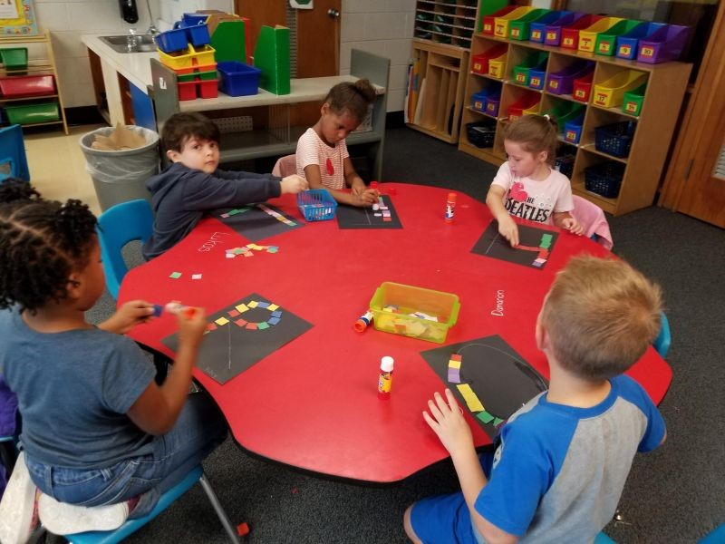
AGE REQUIREMENTS

Slide 13
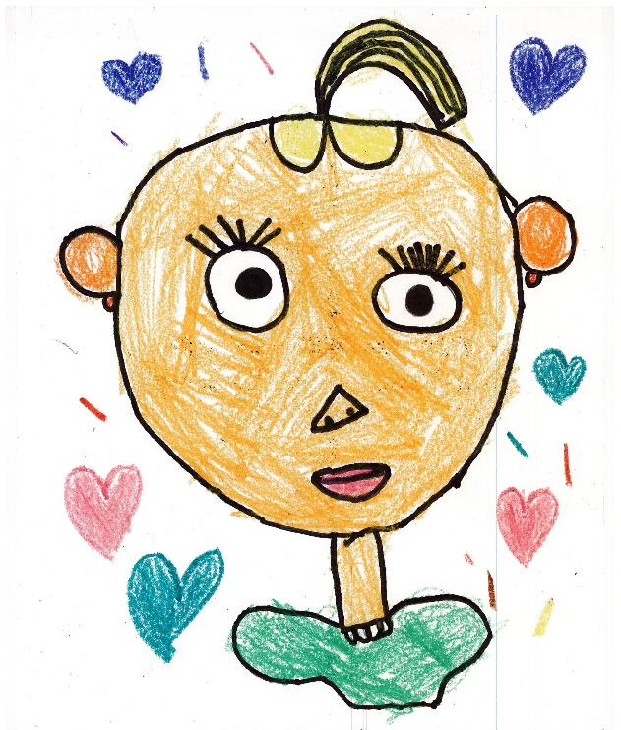
Program Options
Kindergarten Options:
Traditional Kindergarten
Students must be five (5) on or before September 1st.
Transitional Kindergarten (TK)*
*Students who turn five (5) between
September 1st and December 1st.

Slide 14
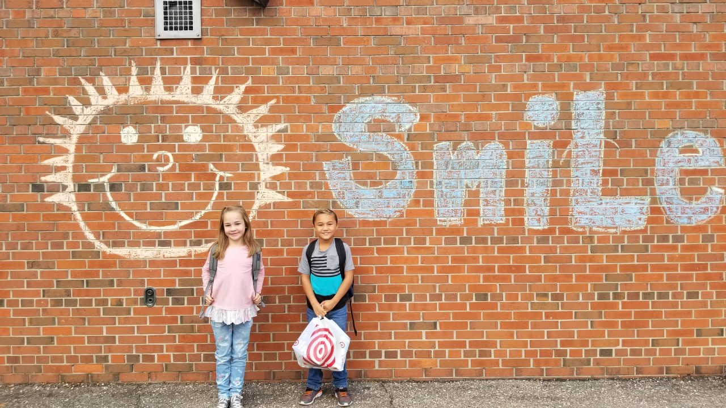
kindergarten
WCS has twelve (12) Elementary Schools
Next fall, WCS will also have a virtual academy, staffed by our teachers, which families can enroll in.
School starts on Tuesday, September 7, 2021

Slide 15
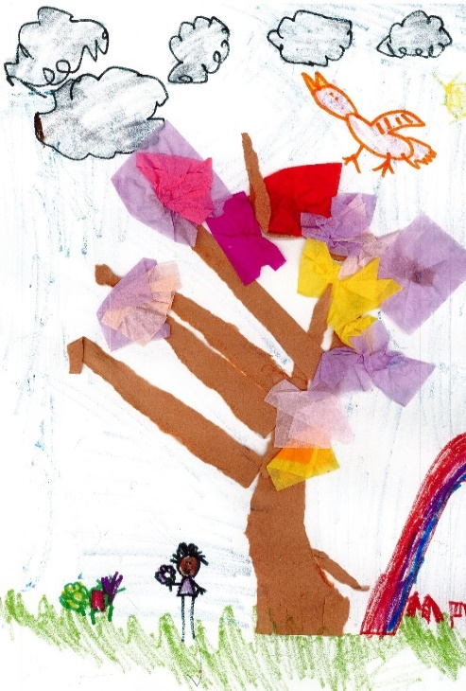
TRANSITIONAL Kindergarten
Available to ALL WCS students who turn five (5) between
September 1st and December 1st.
Currently at:
Cromie
Green Acres
Harwood
Jefferson
Pearl Lean
Siersma
Wilkerson
Transportation is NOT provided, unless to your home school.
Latchkey is available before AND/OR after school.
*Locations subject to change

Slide 16
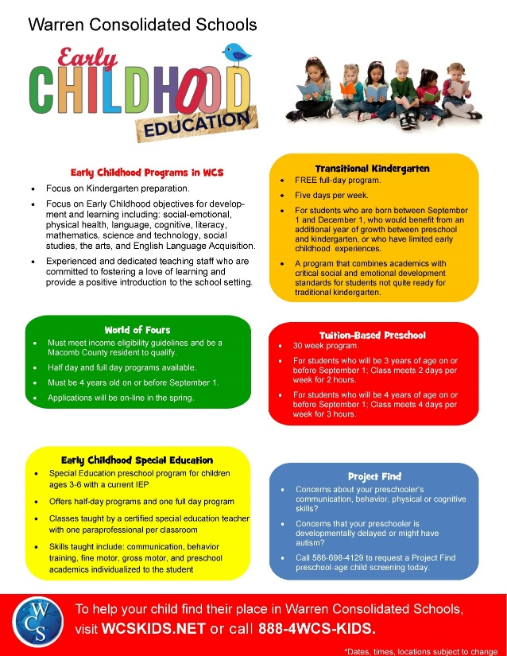
Early childhood Curriculum
All of our early childhood programs
focus on:
Kindergarten preparation​
Early childhood objectives for development, such as literacy, math skills, social-emotional development, physical health, and the arts.

Slide 17
Curriculum
Kindergarten curriculum is comprehensive and includes:
Literacy
Math
Science
Social Studies
STEM
Art
Music
PE
Media/Technology

Slide 18
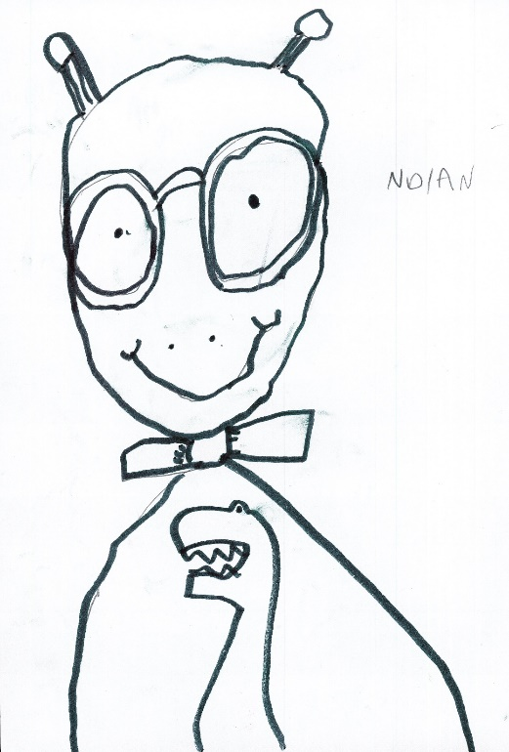
Outcomes
English Language Arts
By the end of kindergarten, you should expect your child to:
Recognize all upper and lowercase letters and their sounds.
Read age-appropriate text.
Use comprehension strategies.
Use a combination of drawing, speaking, and writing to tell stories.
Know conventions: grammar, spelling, and punctuation.

Slide 19
Outcomes
Mathematics
By the end of kindergarten, you should expect your child to:
Count to 100 by ones and tens.
Recognize and write numbers 1-20.
Understand greater than, less than, and equal to.
Classify objects into categories.
Solve basic addition and subtraction problems.

Slide 20
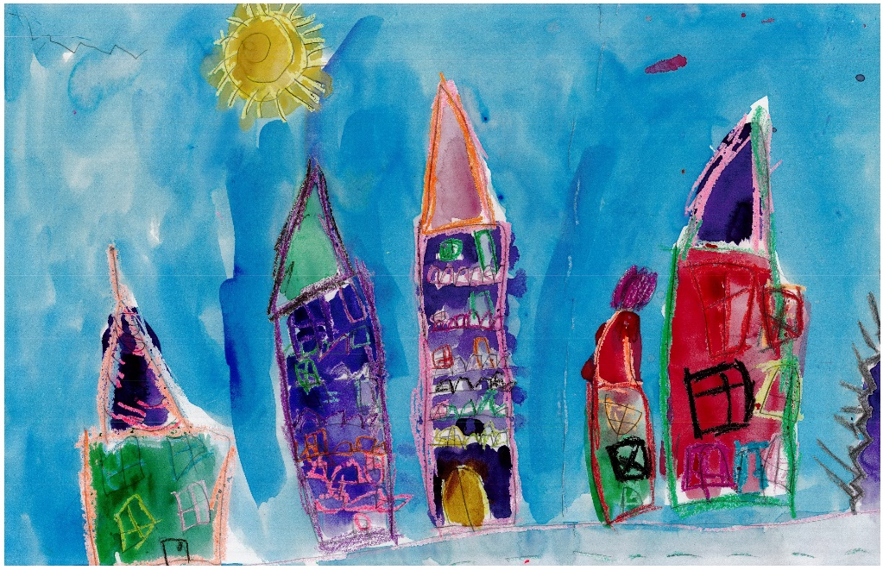
Parent to parent
We have clear benchmarks for our students, but every child is an individual.
If you have questions or concerns, start with your child’s teacher.

Slide 21
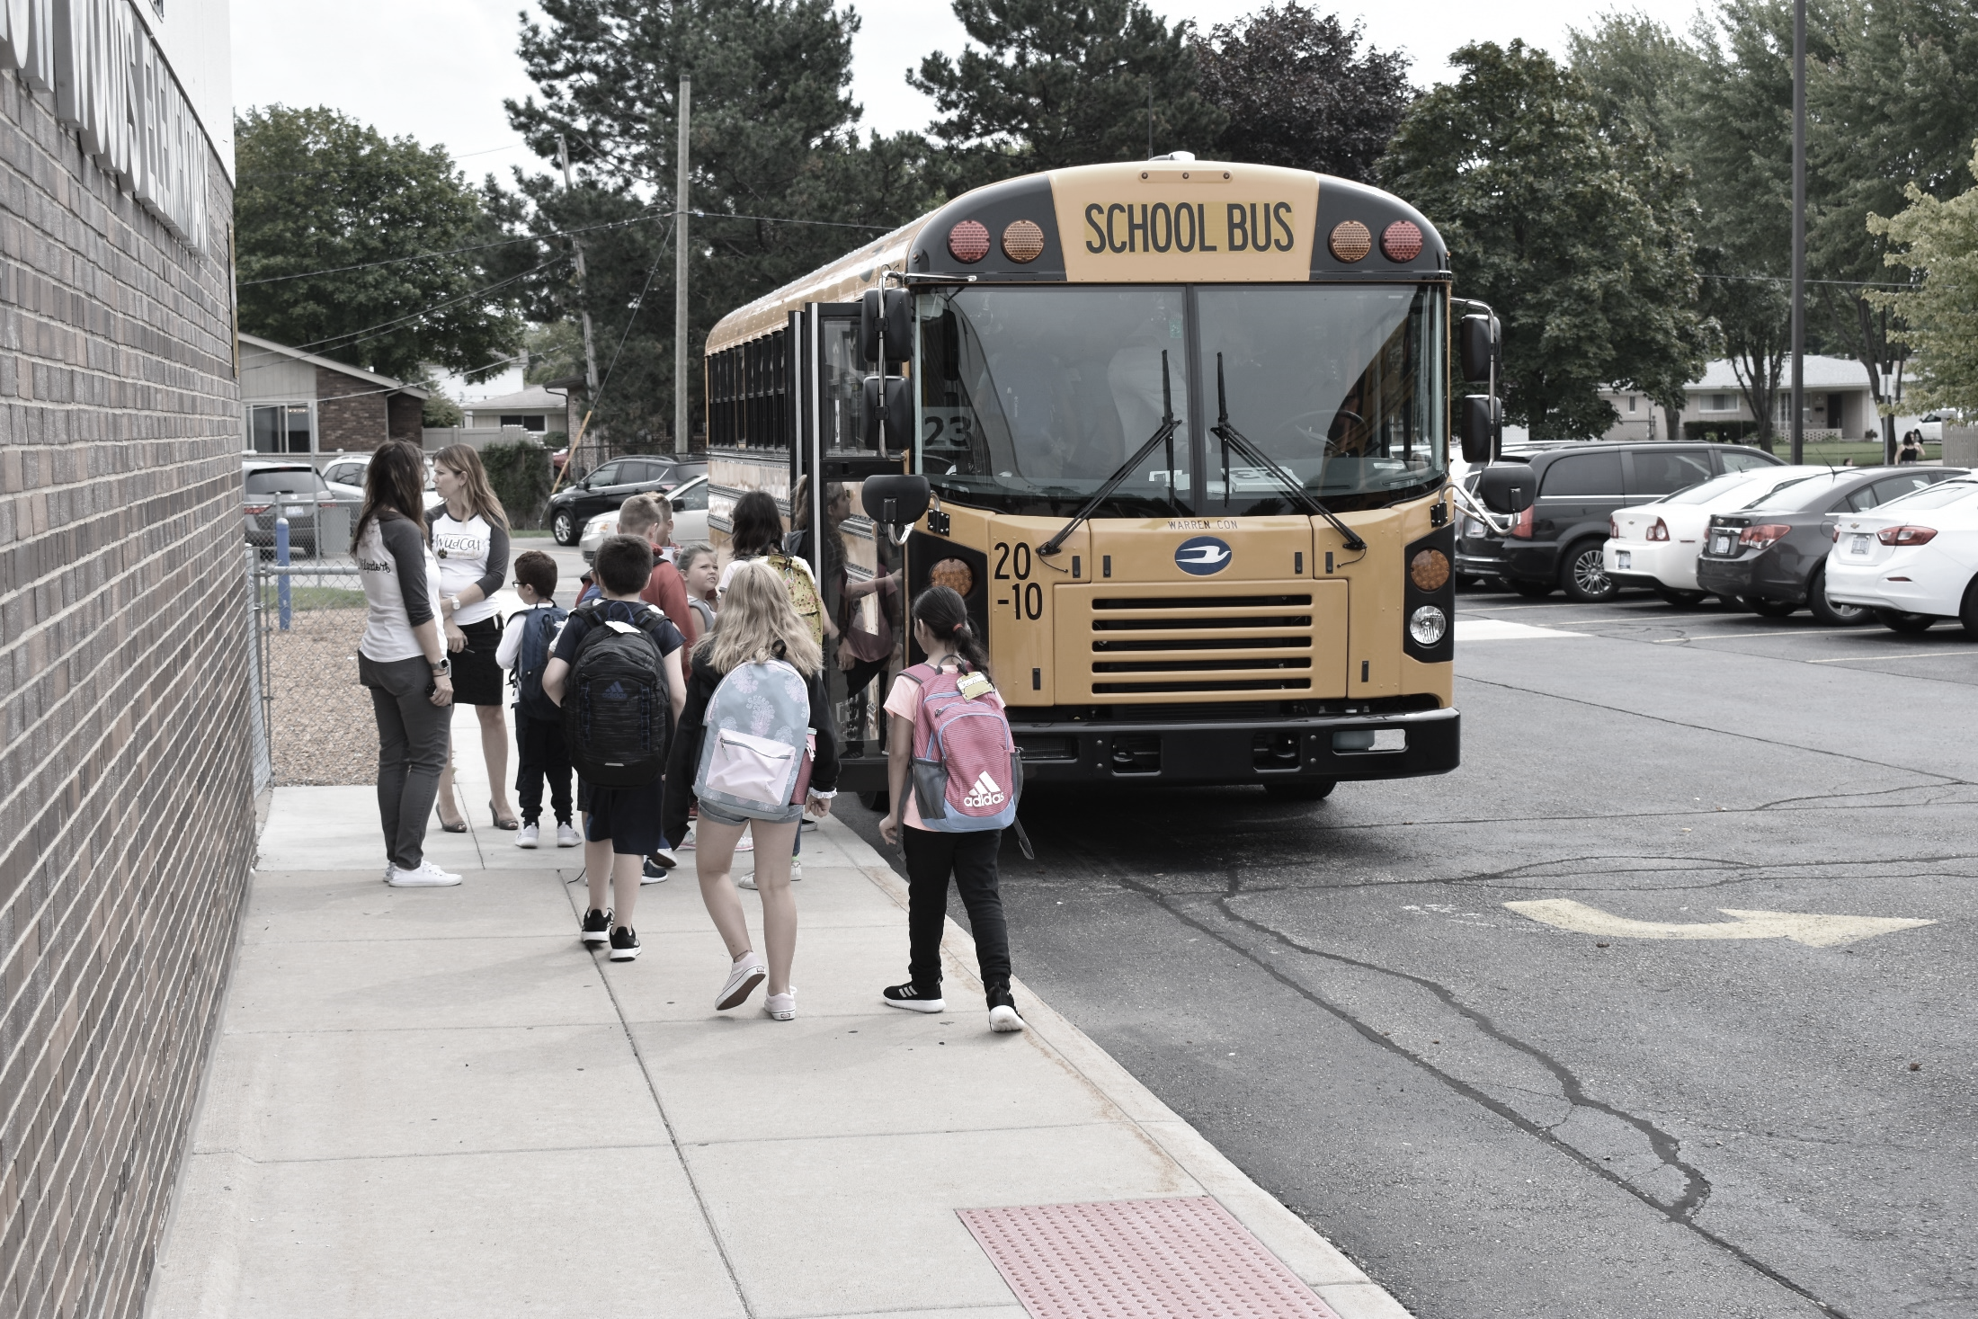
A word from our sponsors
School Nurse
Transportation
Food Service
Registration

Slide 22
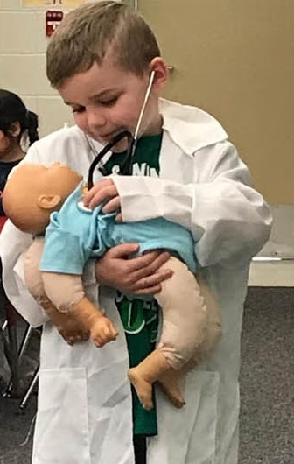
School Nurse
Ann Clark
District Nurse
Ronetta Muha
District Nurse
Required Immunizations
Medication at School
Vision and Hearing
Notes from Nursing

Slide 23
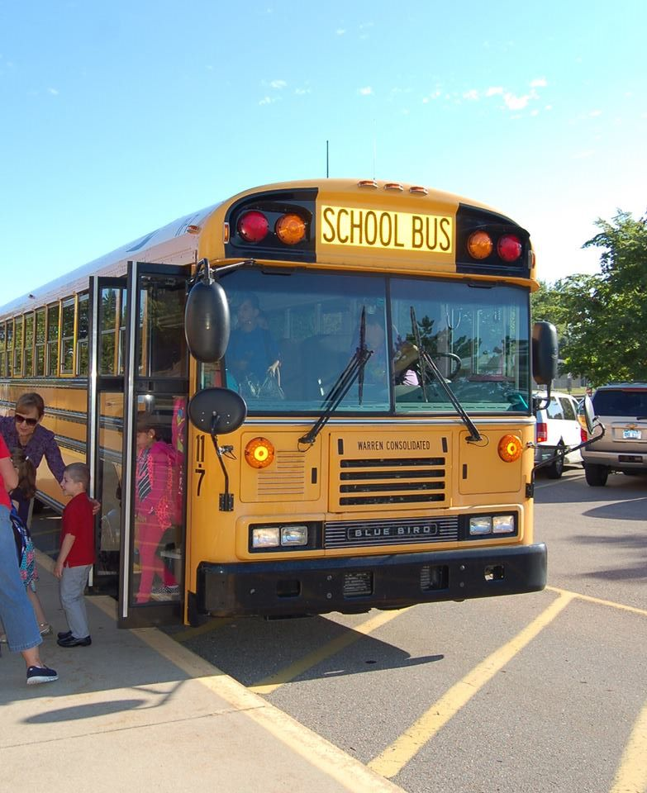
transportation
Rob Selby
Director of Transportation
To check if your child is eligible for transportation, go to:
www.wcskids.net/transportation/webquery
Enter your address
If eligible, bus numbers and bus stops will be listed

Slide 24
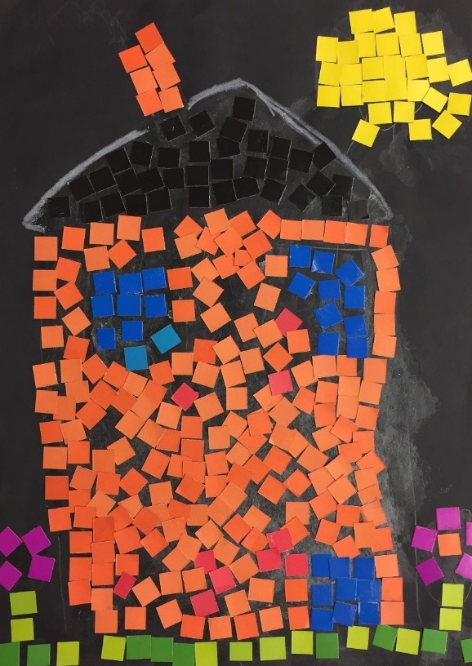
Parent to parent
You or another adult should receive
your child at the bus stop each day.
Please write your child’s name on all personal belongings (hats, gloves, etc).
Pin an ID card to the inside of your child’s backpack.

Slide 25
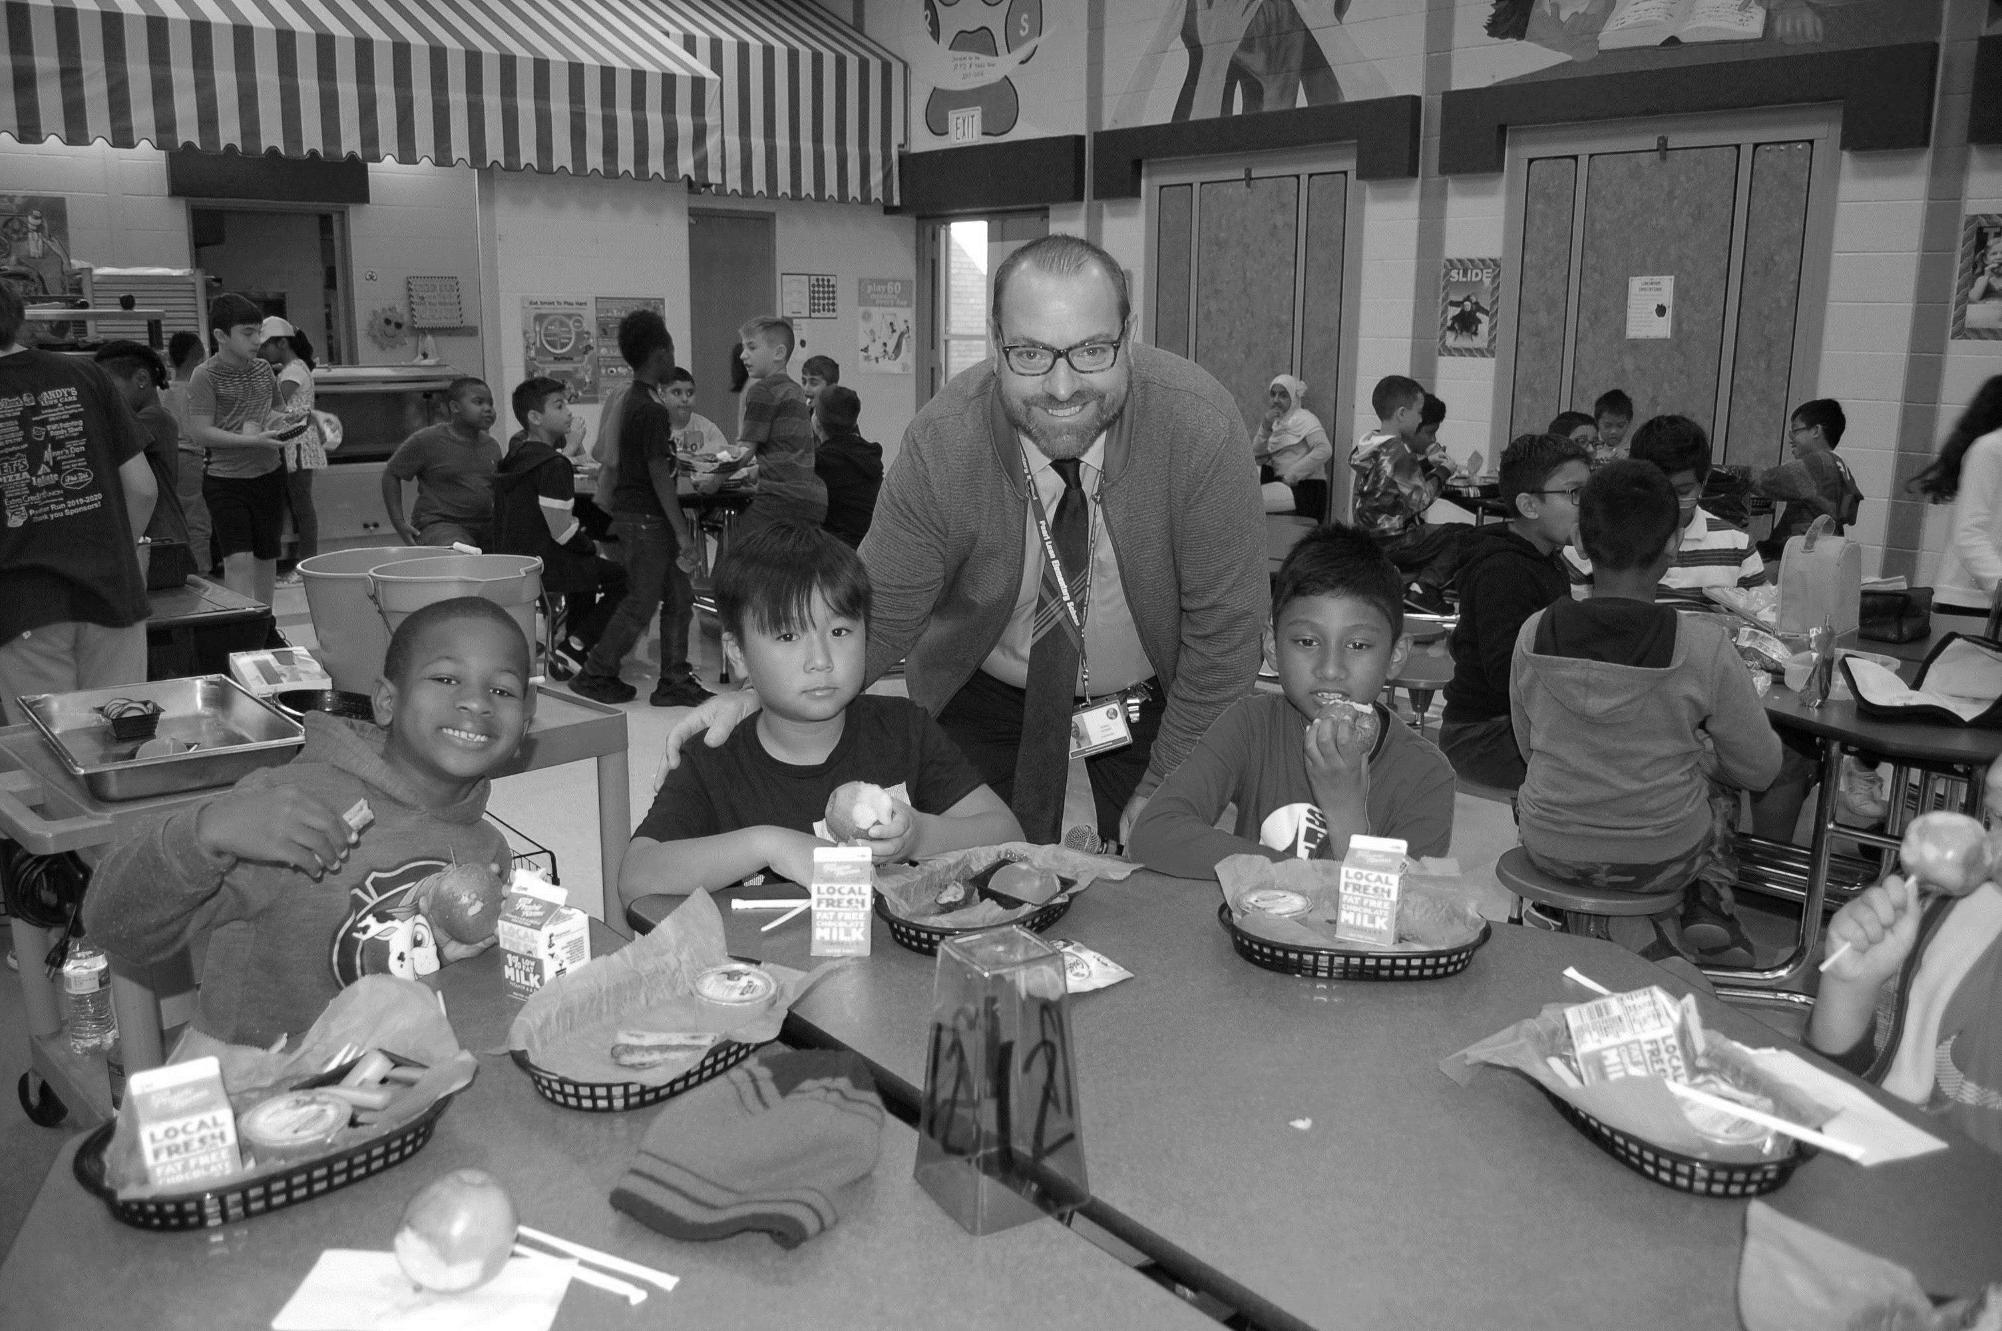
Nutrition Services
Caroline Dylewski
Director of Nutrition Services
Wen Guo
Supervisor of Nutrition Services

Slide 26
Lunch Assistance
If you feel your family may qualify for this benefit, you will need to complete an application.
Applications for 2021-2022 school year can be completed online beginning July 1st at ww.lunchapp.com. This process will allow for a more immediate response.
Paper applications will be available at school, but they will result in a longer response time from the Nutrition Services Office.

Slide 27
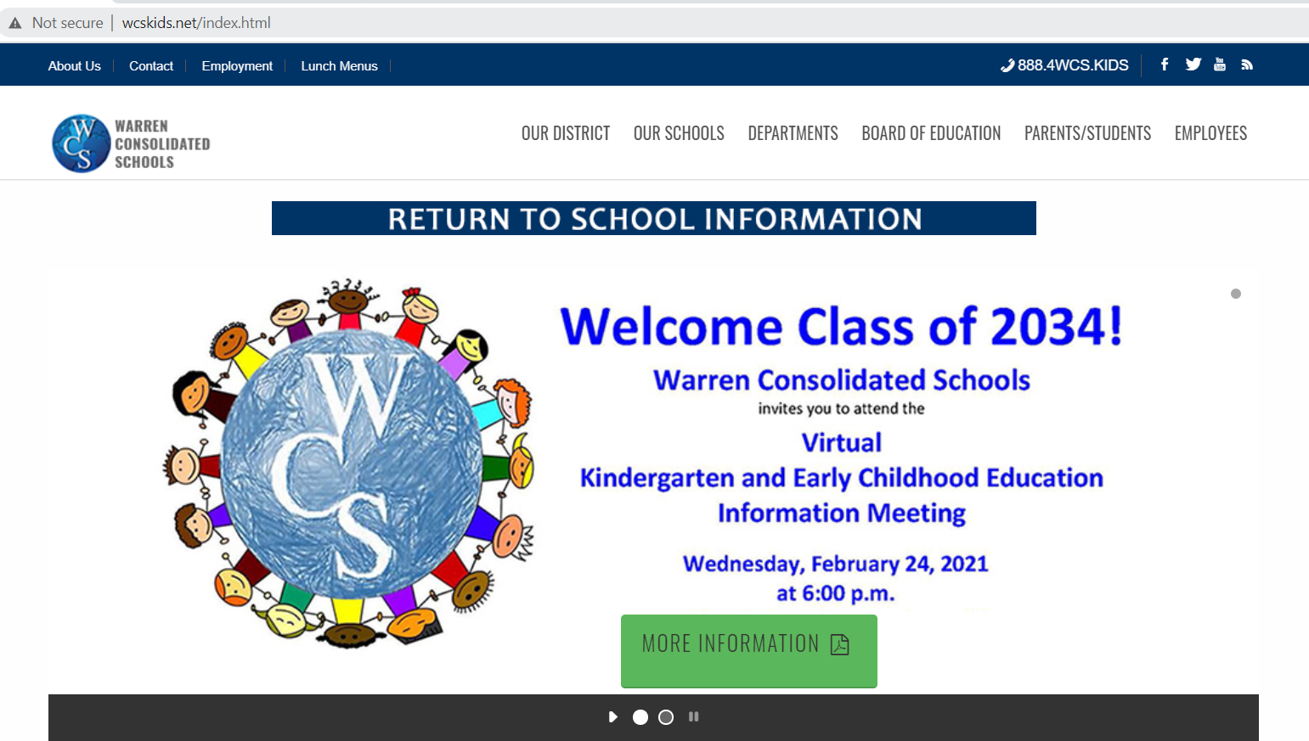
District and registration Information
District Website:
wcskids.net/ClassOf2034
Enrollment and Registration Information
Translation

Slide 28
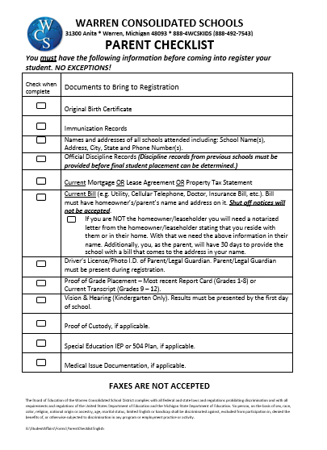
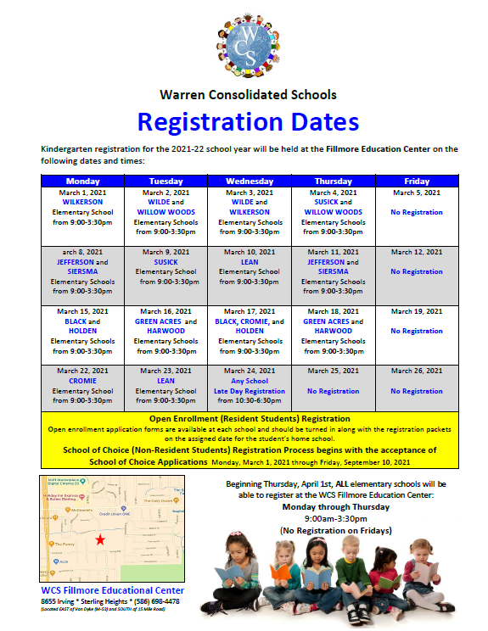
Parent Check List and registration dates

Slide 29
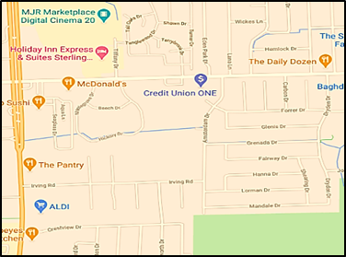
Registration Location
Fillmore Educational Center
8655 Irving Rd.
(EAST of Van Dyke (M-53) and SOUTH of 15 Mile Road)
Mondays, Tuesdays, Wednesday and Thursdays from 9:00-3:30pm
1-888-4WCS-KIDS
(1-888-492-7543)
Fillmore Educational Center
8655 Irving Road * Sterling Heights * Michigan 48093 * (586) 825-2400

Slide 30
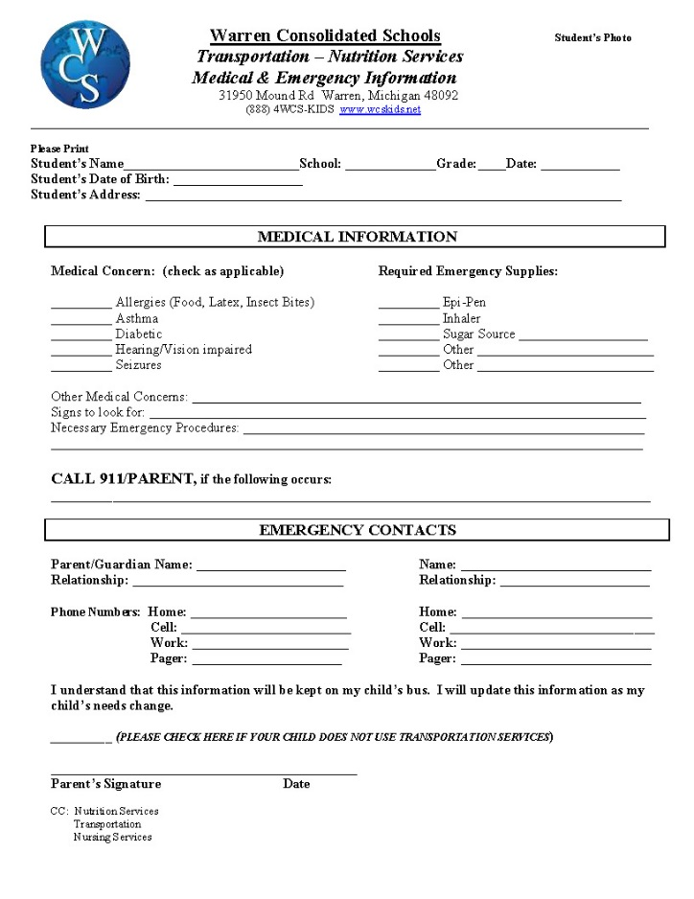
Emergency Information

Slide 31
Federal Requirement
Language Survey
Required by the Federal law, Elementary and Secondary Education Act (ESEA) (formerly known as No Child Left Behind)

Slide 32
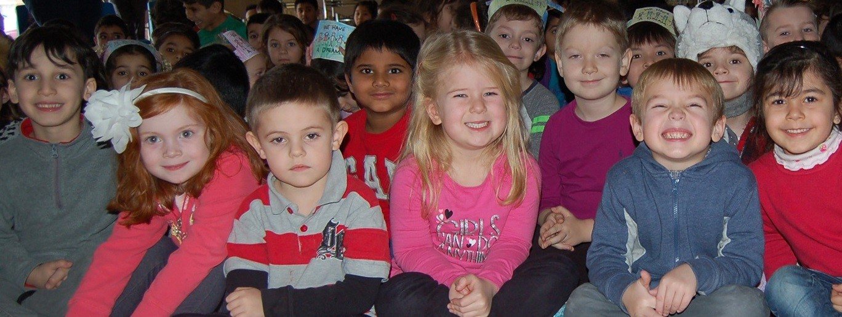
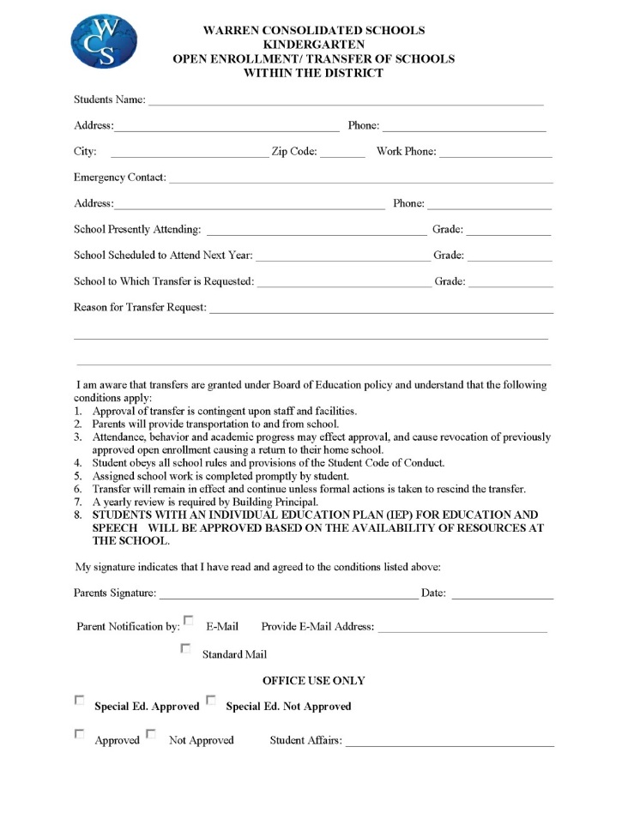
Open Enrollment

Slide 33
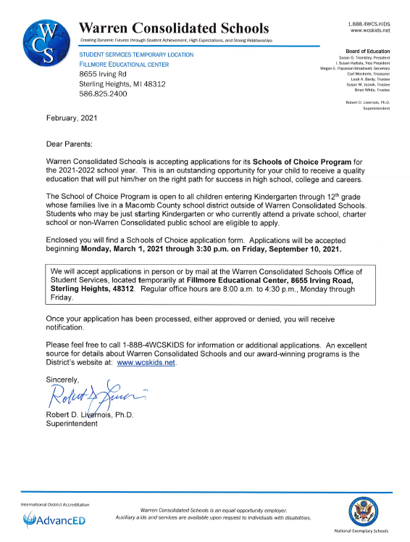
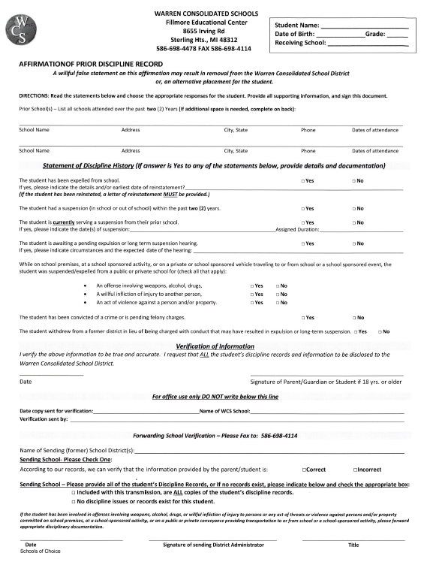
School of Choice
School of Choice Registration
Begins March 1, 2021

Slide 34
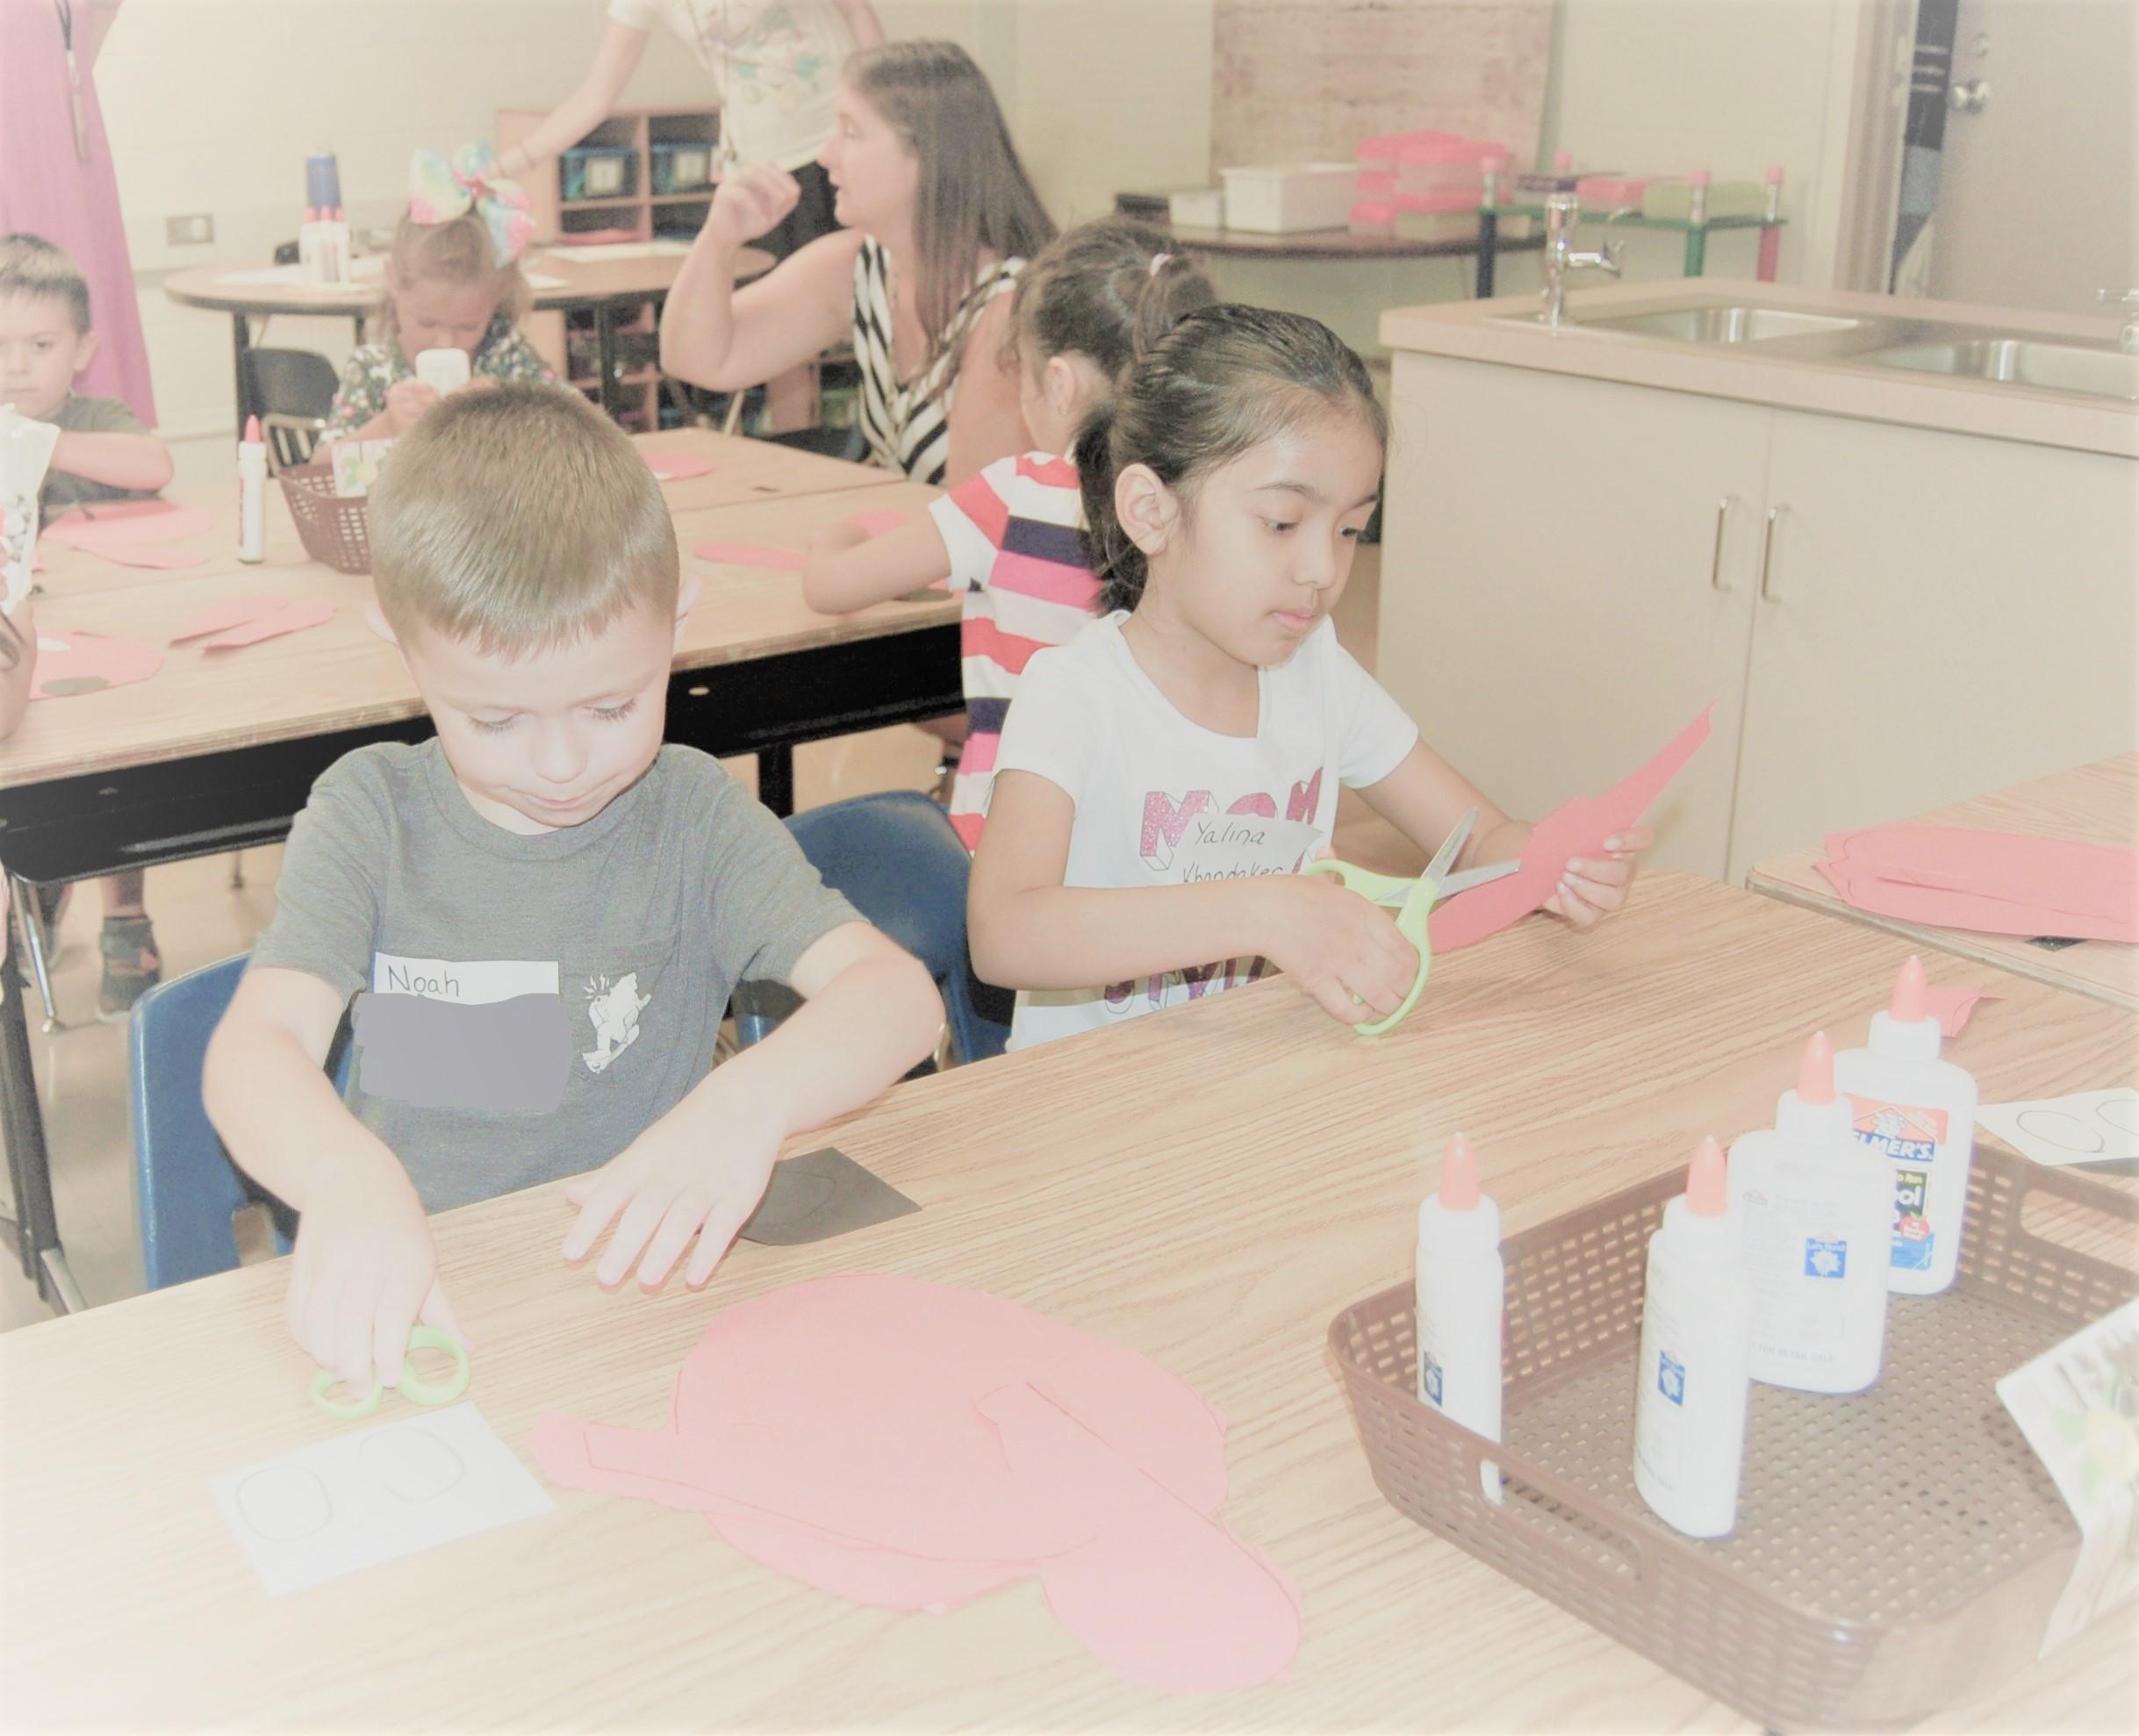
Parent to parent
Some helpful things you can do:
Make sure your son/daughter knows your name and address.
Make sure your son/daughter can zip their own coat.
Introduce your son/daughter to the public library.
When appropriate, “allow the struggle” and teach them “the power of yet.”

Slide 35
Welcome Class of 2034!
WARREN CONSOLIDATED SCHOOLS
CREATING DYNAMIC FUTURES

